Slide 1
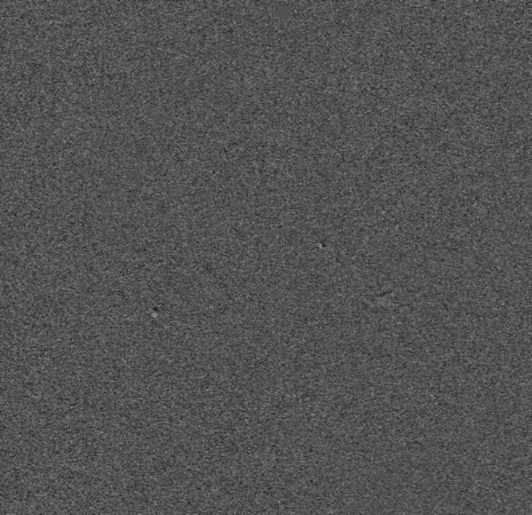
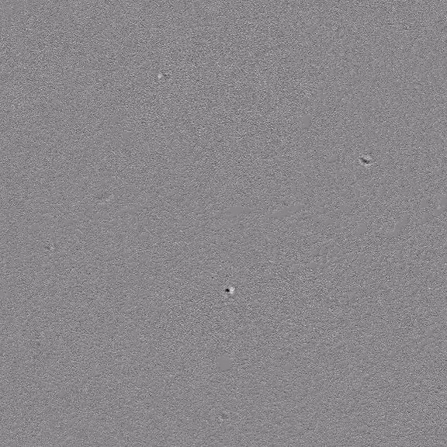

Videos: Plasma samples HCR 001 and HCR 55
Sample HCR 001
Sample HCR 55 (1st batch)
Sample HCR 55 (2nd batch)
Video taken at time 90 and 30 min
Few exosome-like particles appear.
Abnormal large structures show up.
The Background IR 1±0.01
Scale Bar: 10 µm

